Slide 1
Chapter 7:
Computer and
Network Security

Slide 2
Chapter Overview
Introduction
Hacking
Malware
Cyber crime and cyber attacks
Online voting
1-<number>

Slide 3
7.1 Introduction
Computers getting faster and less expensive
Utility of networked computers increasing
  Shopping and banking
  Managing personal information
  Controlling industrial processes
Increasing use of computers → growing importance of computer security
1-<number>

Slide 4
7.2 Hacking
1-<number>

Slide 5
Hackers, Past and Present
Original meaning of hacker: explorer, risk taker, system innovator
  MIT’s Tech Model Railroad Club in 1950s
1960s-1980s: Focus shifted from electronics to computers and networks
  1983 movie WarGames
Modern meaning of hacker: someone who gains unauthorized access to computers and computer networks
1-<number>

Slide 6
Obtaining Login Names, Passwords
Eavesdropping
Dumpster diving
Social engineering
1-<number>

Slide 7
Password Dos and Don’ts
Do not use short passwords.
Do not use a word from the dictionary.
Do not rely on substituting numbers for letters.
Do not reuse passwords.
Give ridiculous answers to security questions.
Enable two-factor authentication if available.
Have password recoveries sent to a secure email address.
1-<number>

Slide 8
Computer Fraud and Abuse Act
Criminalizes wide variety of hacker-related activities
  Transmitting code that damages a computer
  Accessing any Internet-connected computer without authorization
  Transmitting classified government information
  Trafficking in computer passwords
  Computer fraud
  Computer extortion
Maximum penalty: 20 years in prison and $250,000 fine
1-<number>

Slide 9
Sidejacking
Sidejacking: hijacking of an open Web session by capturing a user’s cookie
Sidejacking possible on unencrypted wireless networks because many sites send cookies “in the clear”
Internet security community complained about sidejacking vulnerability for years, but ecommerce sites did not change practices
1-<number>

Slide 10
Case Study: Firesheep
October 2010: Eric Butler released Firesheep extension to Firefox browser
Firesheep made it possible for ordinary computer users to easily sidejack Web sessions
More than 500,000 downloads in first week
Attracted great deal of media attention
Early 2011: Facebook and Twitter announced options to use their sites securely
1-<number>

Slide 11
Act Utilitarian Analysis
Release of Firesheep led media to focus on security problem
Benefits were high: a few months later Facebook and Twitter made their sites more secure
Harms were minimal: no evidence that release of Firesheep caused big increase in identity theft or malicious pranks
Conclusion: Release of Firesheep was good
1-<number>

Slide 12
Virtue Ethics Analysis
By releasing Firesheep, Butler helped public understand lack of security on unencrypted wireless networks
Butler’s statements characteristic of someone interested in protecting privacy
Butler demonstrated courage by taking responsibility for the program
Butler demonstrated benevolence by making program freely available
His actions and statements were characteristic of someone interested in the public good
1-<number>

Slide 13
Kantian Analysis
Accessing someone else’s user account is an invasion of their privacy and is wrong
Butler provided a tool that made it much simpler for people to do something that is wrong, so he has some moral accountability for their misdeeds
Butler was willing to tolerate short-term increase in privacy violations in hope that media pressure would force Web retailers to add security
He treated victims of Firesheep as a means to his end
It was wrong for Butler to release Firesheep
1-<number>

Slide 14
7.3 Malware
1-<number>

Slide 15
Viruses
Virus: Piece of self-replicating code embedded within another program (host)
Viruses associated with program files
  Hard disks, floppy disks, CD-ROMS
  Email attachments
How viruses spread
  Diskettes or CDs
  Email
  Files downloaded from Internet
1-<number>

Slide 16
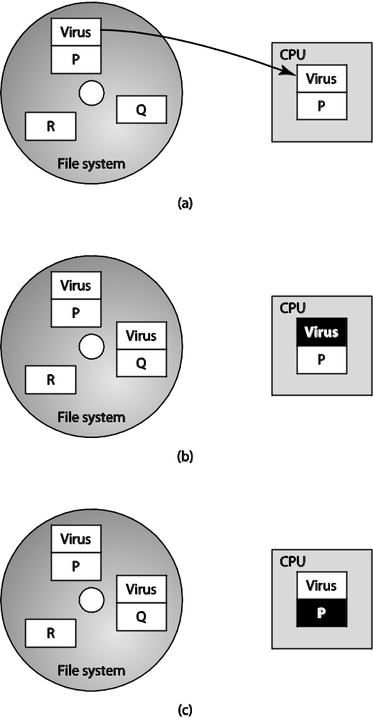
One Way a Virus Can Replicate
1-<number>

Slide 17
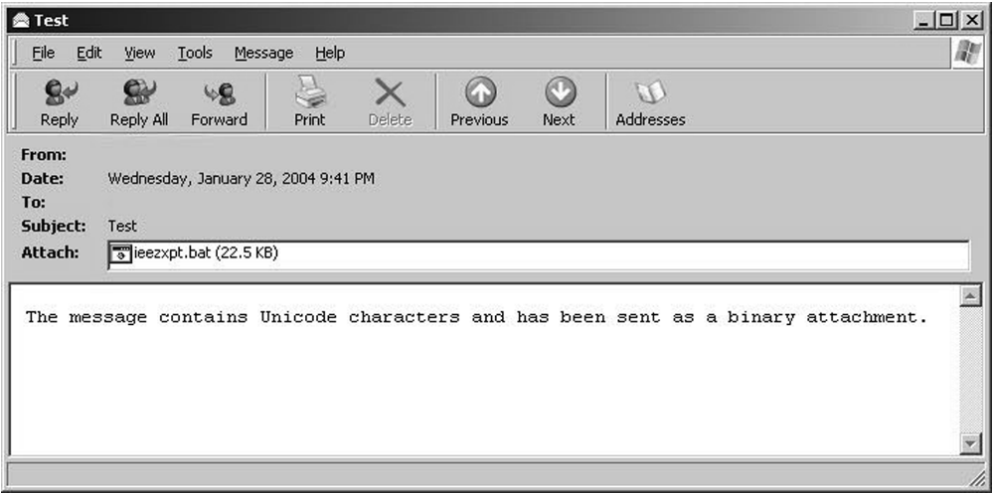
Email Attachment with Possible Virus
1-<number>

Slide 18
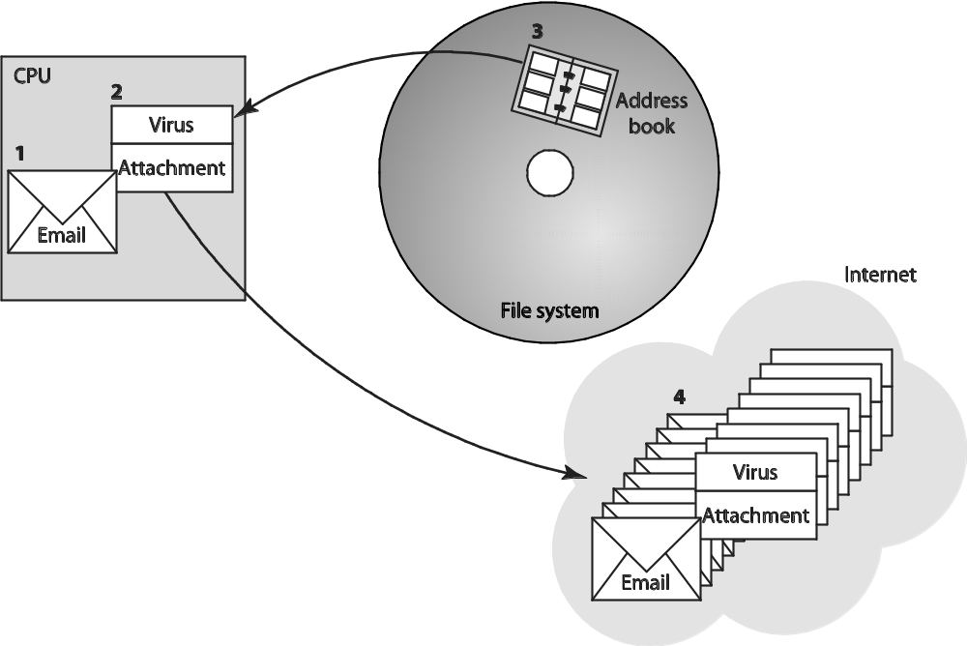
How an Email Virus Spreads
1-<number>

Slide 19
Antivirus Software Packages
Allow computer users to detect and destroy viruses
Must be kept up-to-date to be most effective
Many people do not keep their antivirus software packages up-to-date
Consumers need to beware of fake antivirus applications
1-<number>

Slide 20
Worm
Self-contained program
Spreads through a computer network
Exploits security holes in networked computers
1-<number>

Slide 21
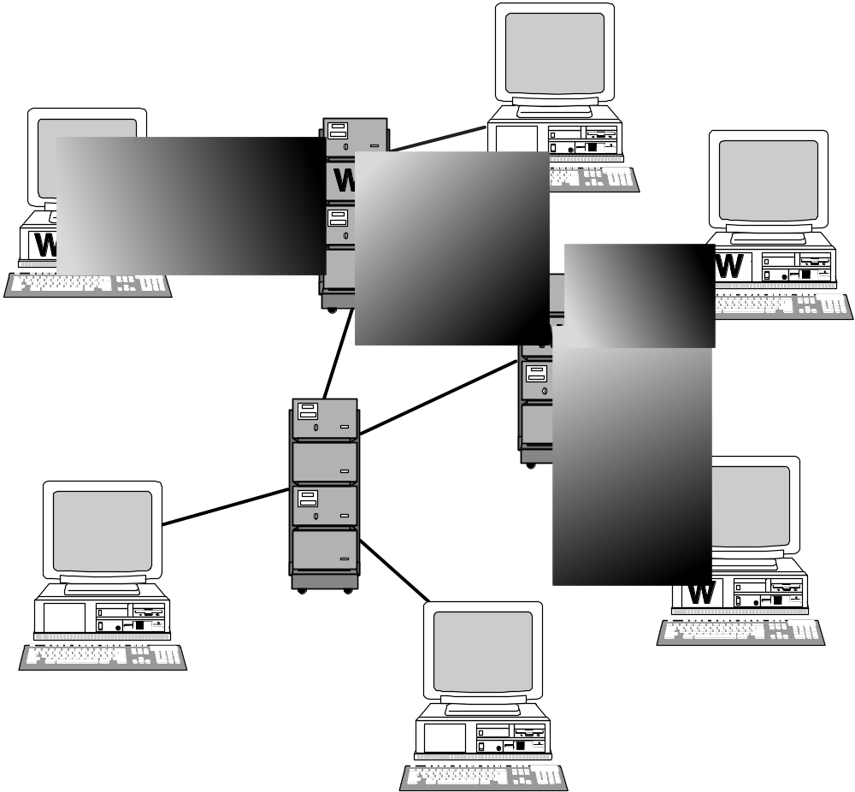
How a Worm Spreads
1-<number>

Slide 22
The Internet Worm
Robert Tappan Morris, Jr.
  Graduate student at Cornell
  Released worm onto Internet from MIT computer
Effect of worm
  Spread to significant numbers of Unix computers
  Infected computers kept crashing or became unresponsive
  Took a day for fixes to be published
Impact on Morris
  Suspended from Cornell
  3 years’ probation + 400 hours community service
  $150,000 in legal fees and fines
1-<number>

Slide 23
Ethical Evaluation
Kantian evaluation
  Morris used others by gaining access to their computers without permission
Social contract theory evaluation
  Morris violated property rights of organizations
Utilitarian evaluation
  Benefits: Organizations learned of security flaws
  Harms: Time spent by those fighting worm, unavailable computers, disrupted network traffic, Morris’s punishments
Virtue ethics evaluation
  Morris selfishly used Internet as experimental lab
  He deceitfully released worm from MIT instead of Cornell
  He avoided taking responsibility for his actions
Morris was wrong to have released the Internet worm
1-<number>

